Slide 1


&inator: Correct, Precise C-to-Rust Interface Translation
Victor Chen, Ayden Coughlin, Michael D. Bond
The Ohio State University
Notes:
&inator, which is correct, precise automated C-to-safe Rust interface translation that enables modular C-to-safe Rust whole-program translation.

Slide 2
Outline
Motivation and Background
Interface Translation: Problem Setup and Challenges
&inator Architecture and Technical Insights
&inator Constraints: Overview and Examples
Correctness, Precision, and Performance Results

Slide 3
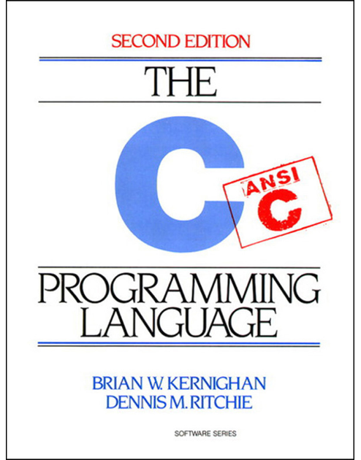

Motivation
strcpy
💥
free(p); free(p);
💥
SIGSEGV
(safe Rust)
💥
Notes:
C is famously not memory-safe
Memory safety bugs: encountered frequently and have enormous real-world cost
Transitioning away from non-memory-safe languages
Safe Rust: Memory-safe + performant, suitable for similar use cases as C (for user programs)
Goal: Automatically translate C to safe Rust to remove memory-safety bugs

Slide 4
Background
Central difficulty: Rust’s strict ownership and borrowing rules.
C
Mechanical translator
Rust
Accepts the input?
Free of unsafe Rust?
C
Rust
LLM
Compiles? Semantically correct?
Notes:
Translating C to safe Rust turns out to be hard
Central difficulty: Rust's strict ownership and borrowing rules; requires precise whole-program reasoning to satisfy.
Categories of approaches:
Mechanical [e.g., c2rust, Laertes, CROWN, Scylla]; Pitfalls: Accepts the input? Result is unsafe-free?
LLM-based [e.g., Tymcrat, C2SaferRust, Oxide (Go -> Rust), SACTOR]; Pitfalls: Result is semantically correct? Compiles?

Slide 5
Modular Translation
Interface: struct definitions + global variables + function signatures
whole-program
Interface translation
&inator
C
correct, precise Rust interface
Rust
Code translation
modular
Notes:
To address the difficulty of satisfying Rust’s ownership and borrowing rules, we envision the following translation method (envisioned use case of &inator):
Determine a correct and precise safe Rust interface
Interfaces: (1) struct definitions, (2) global variables, (3) function signatures
Will define correctness and precision in a moment
Requires whole-program reasoning
Translate function bodies, using chosen interfaces
Since the interfaces are chosen to be correct and precise, the function bodies will fit together
All necessary whole-program reasoning done in the last step, so this step is modular
&inator is the first step: correct, precise C-to-Rust interface translation.

Slide 6
Outline
Motivation and Background
Interface Translation: Problem Setup and Challenges
&inator Architecture and Technical Insights
&inator Constraints: Overview and Examples
Correctness, Precision, and Performance Results
Notes:
So, what exactly is the translation problem &inator solves?
To understand the interface translation problem that &inator solves, we’ll:
Examine some challenges of translating an entire C program (incl. function bodies) into Rust

Slide 7
Interface Translation: Example
C
struct Node {
int data;
struct Node *next;
};
void push(
struct Node *list,
int x,
)
{
struct Node *n =
malloc(sizeof(struct Node));
n->data = x;
n->next = list->next;
list->next = n;
}
Notes:
Snippet of a program that operates on a linked list (with a dummy node at the front)
One struct (Node): linked list node
One function (push): Takes a pointer-to-node parameter and an int parameter; pushes to beginning of the list (after the dummy node)
Note: Showing Rust translated code for exposition -- &inator doesn’t output a Rust program, just the interface

Slide 8
Interface Translation: Interface
C
Rust
struct Node {
int data;
struct Node *next;
};
void push(
struct Node *list,
int x,
)
{
struct Node *n =
malloc(sizeof(struct Node));
n->data = x;
n->next = list->next;
list->next = n;
}
struct Node {
data: i32,
next: Option<Rc<RefCell<<Node>>>,
}
fn push(
list: &mut Node,
x: i32,
) -> ()
{
let n = Rc::new(RefCell::new(Node {
data: x,
next: list.next.take(),
}));
list.next = Some(n);
}
Notes:
For each top-level declaration (here: the struct definition and the function signature) in C:
Find a corresponding declaration in Rust
In other words… change all the C types to Rust types
Rust interface must be correct and precise
But, choosing a correct and precise Rust interface is tough because a single C type can correspond to many Rust types.

Slide 9
Complication: Mapping C Types to Rust
C
Rust
T
Box<T>
Rc<T>
Rc<RefCell<T>>
&T
T*
&mut T
&[T]
Option<Box<T>>
Option<Rc<RefCell<T>>>
…
Notes:
In particular, the C pointer...
For pointers, the choice in Rust type restricts what you can do with it: namely restrictions on copying or aliasing (part of Rust’s ownership and borrowing system)
This leads into our definition of correctness…

Slide 10
Interface Translation: Correctness
Existence of a semantics-preserving implementation given the interface.
preserve copying + aliasing
valid safe Rust
C
Rust
struct Node {
int data;
struct Node *next;
};
void push(
struct Node *list,
int x,
)
{
struct Node *n =
malloc(sizeof(struct Node));
n->data = x;
n->next = list->next;
list->next = n;
}
struct Node {
data: i32,
next: Option<Rc<RefCell<<Node>>>,
}
fn push(
list: &mut Node,
x: i32,
) -> ()
{
let n = Rc::new(RefCell::new(Node {
data: x,
next: list.next.take(),
}));
list.next = Some(n);
}
Notes:
Correctness:
Given the Rust interface, there exists a safe Rust implementation that preserves the semantics of the input C program
Semantics-preserving: Copying and aliasing behavior is preserved
Implementation: Must be safe Rust that compiles (challenging part is satisfying ownership + borrow-checking)
We only care about translating the interfaces, but:
The correct interface depends on the possible bodies (implementations) [existence of a semantics-preserving implementation]
&inator translates interfaces by reasoning about possible translated bodies, without actually translating the bodies.
To understand correctness, we’ll look at possible translated bodies
Here: I’ll point out one way the correct interface depends on the body of push.

Slide 11
Interface Translation: Correctness
Semantics Allocate n, then copy n into list->next
C
Rust
struct Node {
int data;
struct Node *next;
};
void push(
struct Node *list,
int x,
)
{
struct Node *n =
malloc(sizeof(struct Node));
n->data = x;
n->next = list->next;
list->next = n;
}
struct Node {
data: i32,
next: Option<Rc<RefCell<<Node>>>,
}
fn push(
list: &mut Node,
x: i32,
) -> ()
{
let n = Rc::new(RefCell::new(Node {
data: x,
next: list.next.take(),
}));
list.next = Some(n);
}
Notes:
Allocate a Node on the heap and get a pointer n to it, then copy n into list->next.

Slide 12
Interface Translation: Correctness
Semantics Allocate n, then copy n into list->next
Implementation Allocate n, then transfer ownership of n to list.next
C
Rust
struct Node {
int data;
struct Node *next;
};
void push(
struct Node *list,
int x,
)
{
struct Node *n =
malloc(sizeof(struct Node));
n->data = x;
n->next = list->next;
list->next = n;
}
struct Node {
data: i32,
next: Option<Rc<RefCell<<Node>>>,
}
fn push(
list: &mut Node,
x: i32,
) -> ()
{
let n = Rc::new(RefCell::new(Node {
data: x,
next: list.next.take(),
}));
list.next = Some(n);
}
Notes:
In the Rust implementation, we need to contend with its ownership and borrowing rules…
Ownership:
All objects have an owner, objects dropped when owner goes out of scope
When n is initialized, it owns the Node it points to
list.next = Some(n) transfers ownership of the Node that n points to to list.next
Avoiding this ownership transfer (by using different types) => implementation won’t compile due to borrow checker

Slide 13
Interface Translation: Correctness
Semantics Allocate n, then copy n into list->next
Implementation Allocate n, then transfer ownership of n to list.next
Interface The type of Node::next must be an owning pointer
C
Rust
struct Node {
int data;
struct Node *next;
};
void push(
struct Node *list,
int x,
)
{
struct Node *n =
malloc(sizeof(struct Node));
n->data = x;
n->next = list->next;
list->next = n;
}
struct Node {
data: i32,
next: Option<Rc<RefCell<<Node>>>,
}
fn push(
list: &mut Node,
x: i32,
) -> ()
{
let n = Rc::new(RefCell::new(Node {
data: x,
next: list.next.take(),
}));
list.next = Some(n);
}
Notes:
To transfer ownership into list.next, the type of Node::next must be a pointer that owns the object it points to

Slide 14
Interface Translation: Correctness
Semantics Allocate n, then copy n into list->next
Implementation Allocate n, then transfer ownership of n to list.next
Interface The type of Node::next must be an owning pointer
C
Rust
struct Node {
int data;
struct Node *next;
};
struct Node {
data: i32,
next: Option<Rc<RefCell<<Node>>>,
}
❌
&Node
&mut Node
…
Option<Rc<RefCell<Node>>>
✅
Notes:
This rules out some pointer types
&Node, &mut Node are not okay to use
Option<Rc<RefCell<Node>>> is okay
Here, it’s possible to pick a single Rust type for Node::next based on correctness alone.
In our next example, the pointer-to-Node parameter of the push function, that’s not possible. In order to pick a single Rust type, we also consider precision.

Slide 15
Interface Translation: Precision
void push( struct Node *list, int x, ) { /* mutate list */ }
fn push( list: &mut Node, x: i32, ) { /* mutate list */ }
fn push( list: , x: i32, ) { /* mutate list */ }
correct and precise ⭐
correct, but not precise 👎
&Node
&mut Node
&RefCell<Node>
Rc<RefCell<Node>>
less costly
more costly
❌ incorrect
✅ correct
Notes:
Consider the list parameter of push:
Type maps to a pointer to a Node
Correctness rules out some types (&Node: it's not mutable), but many others are okay (&mut Node, &RefCell<Node>, Rc<RefCell<Node>>)
Prefer the simplest (i.e., least costly) correct type (&inator determines precision according to a cost function)

Slide 16
Outline
Motivation and Background
Interface Translation: Problem Setup and Challenges
&inator Architecture and Technical Insights
&inator Constraints: Overview and Examples
Correctness, Precision, and Performance Results
Notes:
To recap, the interface translation problem &inator solves is choosing a correct and precise interface.
With that said, how does &inator solve this problem?

Slide 17
How &inator Works
C
SMT Constraints
&inator IR
(3-address code)
Constraint generation analysis
Conversion to &inator IR
Off-the-shelf SMT Solver
&inator implementation
Rust interface
Notes:
&inator generates SMT constraints to constrain the Rust interface based on possible (correct, precise) Rust implementations.
Up next:
Enabling Technical Insights
Overview + Examples of SMT constraints

Slide 18
Technical Insight: Type Fragments
C types become type fragments
  Simplify constraints + improve performance + adjust indirection
struct Node {
int data;
struct Node * next;
};
void push(
struct Node *list,
int x,
)
{
struct Node *n =
malloc(sizeof(struct Node));
n->data = x;
n->next = list->next;
list->next = n ;
}
struct fields
ptr
ptr
struct(Node)
function returns
void
variables
i32
rvalue expressions
ptr
struct(Node)
Notes:
In &inator’s IR, occurrences of C types are enumerated,
Struct fields, function returns, variables, rvalue expressions
C types broken up into type fragments:
E.g., the struct Node* n at the bottom is split into a two fragments: ptr and struct(Node)
&inator finds an appropriate Rust type for each type fragment
Advantages of type fragments: Simplifies constraints, improves solving performance, also allows adjusting depth of indirection
The source language:
Is a three-address-code intermediate representation
Can simulate Rust borrow checking on top of it
Breaks each occurrence of a C type into source type fragments
Figure shows breakdown of struct fields types into source type fragments
&inator finds a Rust type for each source type fragment
Constraints support adding or removing indirection via type fragments

Slide 19
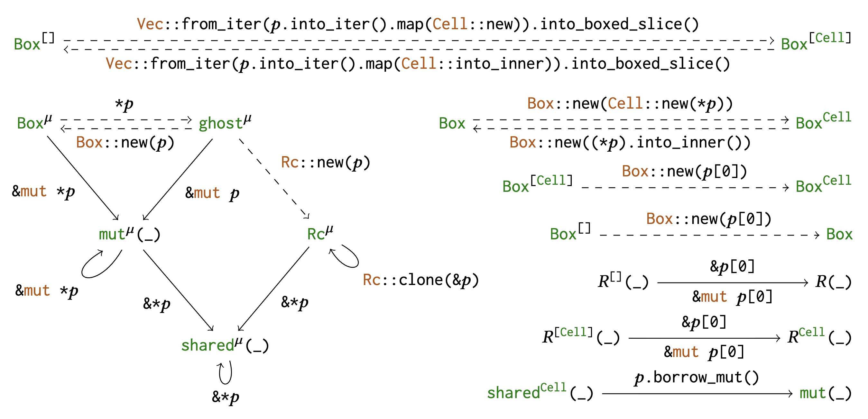
Technical Insight: Transformations
Consider pointer transformations when solving for Rust types
Notes:
Pointer transformations: When choosing Rust types, pointer types are allowed to mismatch as long as a transformation can rectify it (transformations between pointer types are considered)
Allows all correct types to be used
Picture shows all transformations considered by &inator (no need to look too closely)
With these insights in mind, &inator generates the following four categories of constraints.

Slide 20
Constraint Categories
Correctness
Consistency
Semantic Preservation (Move/Copy)
Borrow-Checking
Precision
Optimality Objectives
Notes:
&inator generates constraints that capture reasoning about possible Rust translations of the input C program.
Four categories of constraints:
Three ensure correctness: consistency, semantic preservation, borrow-checking
One ensures precision: encoded using optimality objectives

Slide 21
Example: Consistency Constraint
Constraint Chosen Rust types match C types
void push( struct Node * list, int x, );
&Node
&mut Node
Option<Rc<RefCell<Node>>>
u32
i32
Notes:
Consistency constraints ensure Rust types are consistent with the input program and self-consistent.
Example of consistency constraint: parity

Slide 22
Example: Move/Copy Constraint
Constraint n cannot be copied $⟹$ rvalue expression must not move n
C
Rust
int main() {
struct Node *n = ...;
replace_first(n, 2);
...
/* use n */
}
fn main() {
let n: Box<Node> = ...;
replace_first( &mut *n , 2);
...
/* use n */
}
n remains live
n must not have been moved before this point
Notes:
Semantic preservation constraints ensure copying + aliasing in the input can be replicated in a Rust translation.
Example of semantic preservation (move/copy) constraint
Rust background:
Only certain Rust types can be copied.
For pointers: Can’t arbitrarily copy any pointer like in C, can only do this with certain types.
Constraint: If the Rust type of n isn’t a copiable pointer, then the bold purple rvalue expression must not transfer ownership of (i.e., move) n.
This constraint is due to these facts:
n is first used at replace_first(n, 2), and then later at the end of main.
If n cannot be copied, then ownership of n may be transferred, depending on the choice of Rust type for the purple rvalue expression
If ownership of n is transferred at replace_first(n, 2), then n cannot be used again.

Slide 23
Example: Move/Copy Constraint
Constraint n cannot be copied $⟹$ rvalue expression must not move n
Rust
fn main() {
let n: Box<Node> = ...;
replace_first( &mut *n , 2);
...
/* use n */
}
Box<Node> cannot be copied
✅
&Node
&mut Node
Box<Node>
…
❌
Notes:
Example of semantic preservation (move/copy) constraint
Rust background:
Only certain Rust types can be copied.
For pointers: Can’t arbitrarily copy any pointer like in C, can only do this with certain types.
Constraint: If the Rust type of n isn’t a copiable pointer, then the bold purple rvalue expression must not transfer ownership of (i.e., move) n.
This constraint is due to these facts:
n is first used at replace_first(n, 2), and then later at the end of main.
If n cannot be copied, then ownership of n may be transferred, depending on the choice of Rust type for the purple rvalue expression
If ownership of n is transferred at replace_first(n, 2), then n cannot be used again.
In this translation:
n is Box<Node>
Purple rvalue expression must not move n, which rules out certain types
&Node, &mut Node: okay
Box<Node>, others: not okay

Slide 24
Example: Borrow-Checking Constraint
Constraint list is already borrowed at (⋆) $⟹$ type of rvalue expression is &T
C
Rust
(⋆)
int main() {
struct Node *list = ...;
...
struct Node *sublist = list->next;
...
replace_first(list, 3);
/* use sublist */
}
fn main() {
let mut list: Node = ...;
...
let sublist = /* borrow list.next */;
...
replace_first( &list , 3);
/* use sublist */
}
list is borrowed in this region
Notes:
Borrow-checking constraints ensure the Rust translation borrow-checks.
Example of borrow-checking constraint
Rust background: Borrowing rules
Objects cannot be mutably borrowed by more than one mutable reference at a time
Objects cannot be moved while borrowed
Constraint: If list is already borrowed at (⋆), then the type of the purple rvalue expression is some kind of shared reference
list is borrowed (by sublist) in the boxed region

Slide 25
Example: Borrow-Checking Constraint
Constraint list is already borrowed at (⋆) $⟹$ type of rvalue expression is &T
C
Rust
(⋆)
int main() {
struct Node *list = ...;
...
struct Node *sublist = list->next;
...
replace_first(list, 3);
/* use sublist */
}
fn main() {
let mut list: Node = ...;
...
let sublist = /* borrow list.next */;
...
replace_first( &list , 3);
/* use sublist */
}
Use of list must translate to a shared borrow (&T)
list is borrowed in this region
Notes:
Example of borrow-checking constraint
Rust background: Borrowing rules
Objects cannot be mutably borrowed by more than one mutable reference at a time
Objects cannot be moved while borrowed
Constraint: If list is already borrowed at (⋆), then the type of the purple rvalue expression is some kind of shared reference
list is borrowed (by sublist) in the boxed region
Use of list at (⋆) must be a shared borrow (its type must be some kind of &T reference) to satisfy the borrowing rules

Slide 26
Example: Borrow-Checking Constraint
Constraint list is already borrowed at (⋆) $⟹$ type of rvalue expression is &T
C
Rust
(⋆)
int main() {
struct Node *list = ...;
...
struct Node *sublist = list->next;
...
replace_first(list, 3);
/* use sublist */
}
fn main() {
let mut list: Node = ...;
...
let sublist = /* borrow list.next */;
...
replace_first( &list , 3);
/* use sublist */
}
✅
&Node
&RefCell<Node>
…
Node
&mut Node
…
❌
Notes:
Example of borrow-checking constraint
Rust background: Borrowing rules
Objects cannot be mutably borrowed by more than one mutable reference at a time
Objects cannot be moved while borrowed
Constraint: If list is already borrowed at (⋆), then the type of the purple rvalue expression is some kind of shared reference
list is borrowed (by sublist) in the boxed region
Use of list at (⋆) must be a shared borrow (its type must be some kind of &T reference) to satisfy the borrowing rules
Allowable types: &Node, &RefCell<Node>, etc.
Disallowed types: “bare” Node (forces move), &mut Node (mutable borrow)
This concludes our discussion of the constraints

Slide 27
Outline
Motivation and Background
Interface Translation: Problem Setup and Challenges
&inator Architecture and Technical Insights
&inator Constraints: Overview and Examples
Correctness, Precision, and Performance Results
Notes:
This concludes our discussion of &inator's constraints.
How well does &inator work?

Slide 28
Evaluation
Metrics
Benchmarks
Correctness
Does there exist a correct implementation using &inator’s inferred interface?
Precision
Can we manually produce a correct implementation using an interface that is more precise than &inator’s interface?
Performance
How long does &inator take to infer an interface?
Linked list program (example)
running-example
8 programs from CRUST-Bench [1]
ulidgen, leftpad, amp, nandc, rbtree,
carrays, jccc, tisp
[1] Anirudh Khatry, Robert Zhang, Jia Pan, Ziteng Wang, Qiaochu Chen, Greg Durrett, and Isil Dillig. 2025. CRUST-Bench: A Comprehensive Benchmark for C-to-safe-Rust Transpilation. arXiv:2504.15254 [cs.SE] https://arxiv.org/abs/2504.15254
Notes:
- Don't need to read this out, can just say "correctness, precision, and how &inator's runtime performance"
- Mention limitations of C language features here (around the benchmarks?) Or take it out of the talk.

Slide 29
Results
Program | C LoC | Source instructions | Type fragments | Interface variables | Assertions | Analysis time | Solving time | Correct | Precise
running-example | 41 | 34 | 114 | 14 | 1080 | < 0.1 s | 0.6 s | ✓ | ✓
ulidgen | 69 | 184 | 479 | 3 | 9,370 | 0.1 s | 33 s | ✓ | ✓
leftpad | 72 | 131 | 344 | 6 | 5,900 | 0.1 s | 7.8 s | ✓ | ✓
amp | 99 | 197 | 536 | 17 | 8,860 | 0.1 s | 17 s | ✓ | ✓
nandc | 122 | 383 | 971 | 42 | 6,460 | 0.1 s | 9.9 s | ✓ | ✓
rbtree | 346 | 767 | 2,081 | 43 | 112,000 | 0.1 s | 1,100 s | ✓ | ✓
carrays | 618 | 740 | 1,799 | - | 32,700 | 0.7 s | 150 s | - | -
jccc | 1,394 | 1,983 | 5,016 | - | 188,000 | 4.2 s | 17,000 s | - | -
tisp | 3,656 | 2,908 | 7,540 | - | 283,000 | 7.1 s | 25,000 s | - | -
Evaluated for performance only: carrays, jccc, tisp
Notes:
First 6 visible: Evaluated for correctness, precision, and performance
Next 3: Evaluated for performance only
All interfaces evaluated for correctness and precision were indeed correct and precise
Running time consists of analysis time + solving time: solving time dominates, doesn’t scale well
rbtree is ~350LoC and takes ~20min to solve
Evaluated additional benchmarks for scalability
Interfaces for bottom three are huge, and evaluating correctness + precision is manual, so we didn’t evaluate
Challenges:
Our &inator prototype (namely source language conversion) doesn’t support all C features
”Polymorphism” (e.g., type casts from one pointer type to another), function pointers, variadic functions
Notes
Solving is at generally at least exponential in the number of assertions
Number of assertions for one function is polynomial in the number of instructions in the function
Carrays has lots of relatively small functions (compared to rbtree)

Slide 30

&inator is correct, precise automated C-to-Rust interface translation, enabling modular C-to-Rust program translation
Notes:
&inator does automatic correct, precise C-to-Rust interface translation, which enables modular C-to-Rust program translation.

